Slide 1


Network Adequacy
Data Maintenance Planning
2:00 pm- 3:00 pm Central
March 18, 2025
Regulatory Health Link Division,
Arkansas Insurance Dept., Dept. of Commerce

Slide 2
Agenda
Introductions
Rule 106 change: When?
PTNP final list.
  The one version of truth for provider classifications – not the NA template
  Problems to mull over for action in the next round (June-July?)
    High volume of PCP-Specialty combinations for the same provider
    Acute care Hospitals in Arkansas
Changes in data preparation by Issuers
  Specialty Access Template no longer used
  Justification Template redone
Processes after data submission
  The multiple rounds including “outlier” location review
  Tentative timelines for the multiple rounds
Review new customized justification form
Outlier location review
  What we have so far in this POC

Slide 3
Guiding Principles
Align with available Federal/National standards or efforts if feasible.
Build collaboratively – across organizations, disciplines.
Perfection should not be the enemy of the good.
Build incrementally - Over years and scope.
Apply Pareto’s 80-20 principle for every phase.
Seek lessons learned – from others and within.

Slide 4
Agenda
Introductions
Rule 106 change: When?
PTNP final list.
  The one version of truth for provider classifications – not the NA template
  Problems to mull over for action in the next round (June-July?)
    High volume of PCP-Specialty combinations for the same provider
    Acute care Hospitals in Arkansas
Changes in data preparation by Issuers
  Specialty Access Template no longer used
  Justification Template redone
Processes after data submission
  The multiple rounds including “outlier” location review
  Tentative timelines for the multiple rounds
Review new customized justification form
Outlier location review
  What we have so far in this POC

Slide 5
Rule 106 Change
We delayed modifying Rule 106 because of lack of clarity of what is or is not feasible – there was more than CCIIO Standards involved.
Change draft tentatively planned for July-end (by AID) makes it feasible to get Rule 106 readied for PY2027.

Slide 6
Agenda
Introductions
Rule 106 change: When?
PTNP final list.
  The one version of truth for provider classifications – not the NA template
  Problems to mull over for action in the next round (June-July?)
    High volume of PCP-Specialty combinations for the same provider
    Acute care Hospitals in Arkansas
Changes in data preparation by Issuers
  Specialty Access Template no longer used
  Justification Template redone
Review new customized justification form
Processes after data submission
  The multiple rounds including “outlier” location review
  Tentative timelines for the multiple rounds
Outlier location review
  What we have so far in this POC

Slide 7
High volume of PCP-Specialty combinations
Unusual and recent PTNP change observed by Arkansas DHS.
131 NPIs before switching to CCIIO Provider-Types. It currently stands at 1814 NPIs – more than a 10-fold increase.

Slide 8
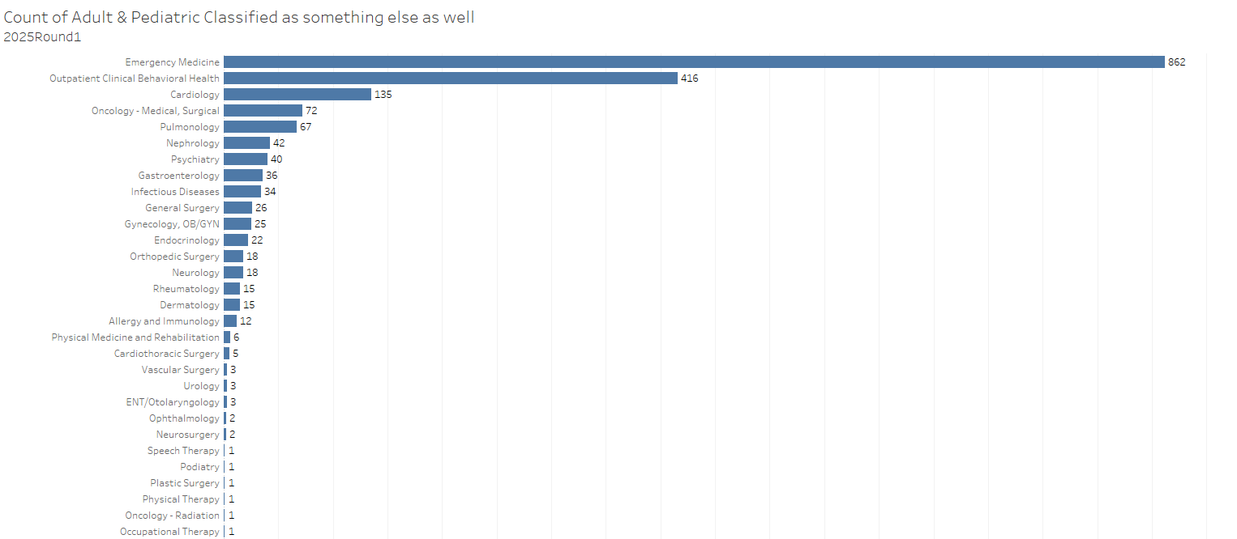

High volume of PCP-Specialty combinations
Unlikely to have impact on Network Adequacy reviews, because…
  Mostly inaccurate classifications as PCPs
  Historically every issuer has been adequate w.r.t. PCPs
Despite low impact - inaccuracies need to be corrected in the next round of PTNP

Slide 9

Acute Care Hospitals
Per CCIIO, AR has 59 Acute Care Hospitals (as of PY2025)
Current PTNP shows 142 NPI classifications. Alarmingly high but…
  The high number includes out-of-state providers
  Multiple NPIs per hospital
Actual count is nearer to 79 hospitals inside Arkansas
  Needs attention.

Slide 10
Agenda
Introductions
Rule 106 change: When?
PTNP final list.
  The one version of truth for provider classifications – not the NA template
  Problems to mull over for action in the next round (June-July?)
    High volume of PCP-Specialty combinations for the same provider
    Acute care Hospitals in Arkansas
Changes in data preparation by Issuers
  Specialty Access Template no longer used
  Justification Template redone
Processes after data submission
  The multiple rounds including “outlier” location review
  Tentative timelines for the multiple rounds
Review new customized justification form
Outlier location review
  What we have so far in this POC

Slide 11


Before PY2026…
AR Specialty Access Template
(County Level-Provider Type Statistics Reported by Issuer)
NA Template
(Detailed Data. NPI & Practicing locations)
AR Supplemental NA Template
(Template to hold provider data for provider types CCIIO would disallow but needed by Arkansas)
Network ID Template
(Identifies unique networks used by issuer.)
AR Provider-Enrollee Ratio Template
(State Level Provider-Enrollee ratios for various provider types)
AR Justification Template
(Justifications for shortcomings on county level statistics for different provider types)
Service Area Template
(Describes service area(s) covered by plans)
Seven data templates were needed for Network Adequacy Regulation

Slide 12


From PY2026…
AR Specialty Access Template
(County Level-Provider Type Statistics Reported by Issuer)
NA Template
(Detailed Data. NPI & Practicing locations)
AR Supplemental NA Template
(Template to hold provider data for provider types CCIIO would disallow but needed by Arkansas)
Network ID Template
(Identifies unique networks used by issuer.)
AR Provider-Enrollee Ratio Template
(State Level Provider-Enrollee ratios for various provider types)
AR Justification Template
(Justifications for shortcomings on county level statistics for different provider types)
Service Area Template
(Describes service area(s) covered by plans)
Five templates, not seven, required during data submission time from PY2026.

Slide 13
In summary, for data submissions
5 templates, not 7 needed.
Issuers are not required to compute Network Adequacy.
No “up-front” justifications to deal with.

Slide 14
Agenda
Introductions
Rule 106 change: When?
PTNP final list.
  The one version of truth for provider classifications – not the NA template
  Problems to mull over for action in the next round (June-July?)
    High volume of PCP-Specialty combinations for the same provider
    Acute care Hospitals in Arkansas
Changes in data preparation by Issuers
  Specialty Access Template no longer used
  Justification Template redone
Processes after data submission
  The multiple rounds including “outlier” location review
  Tentative timelines for the multiple rounds
Review new customized justification form
Outlier location review
  What we have so far in this POC

Slide 15
Processes after data submissions
Round 0:
  AID identifies “outlier” addresses and shares with issuers.
  Issuers responds with revised NA templates if required.
Round 1:
  AID computes “ideal network” combining all networks.
    This is necessary for generating objections where improvement is possible. This also means “No providers available” is not a valid answer.
  AID computes individual networks and compares to ideal network to generate customized Justification Templates.
  Issuers responds with revised NA templates if required.
Round 2:
  For final dispositions, AID re-computes individual networks for for issuers who resubmitted NA templates at the end of Round 1

Slide 16

Round 0: Outlier Address Reporting
NA Template
(Detailed Data. NPI & Practicing locations)
Current Finalized Provider Type NPI Pool (PTNP)
(Provider classifications vetted by the industry)
Provider classifications
Provider locations
Outlier/isolated provider location detection
Outlier Addresses
Customized
Outlier Address Reports
For Issuer Review

Slide 17
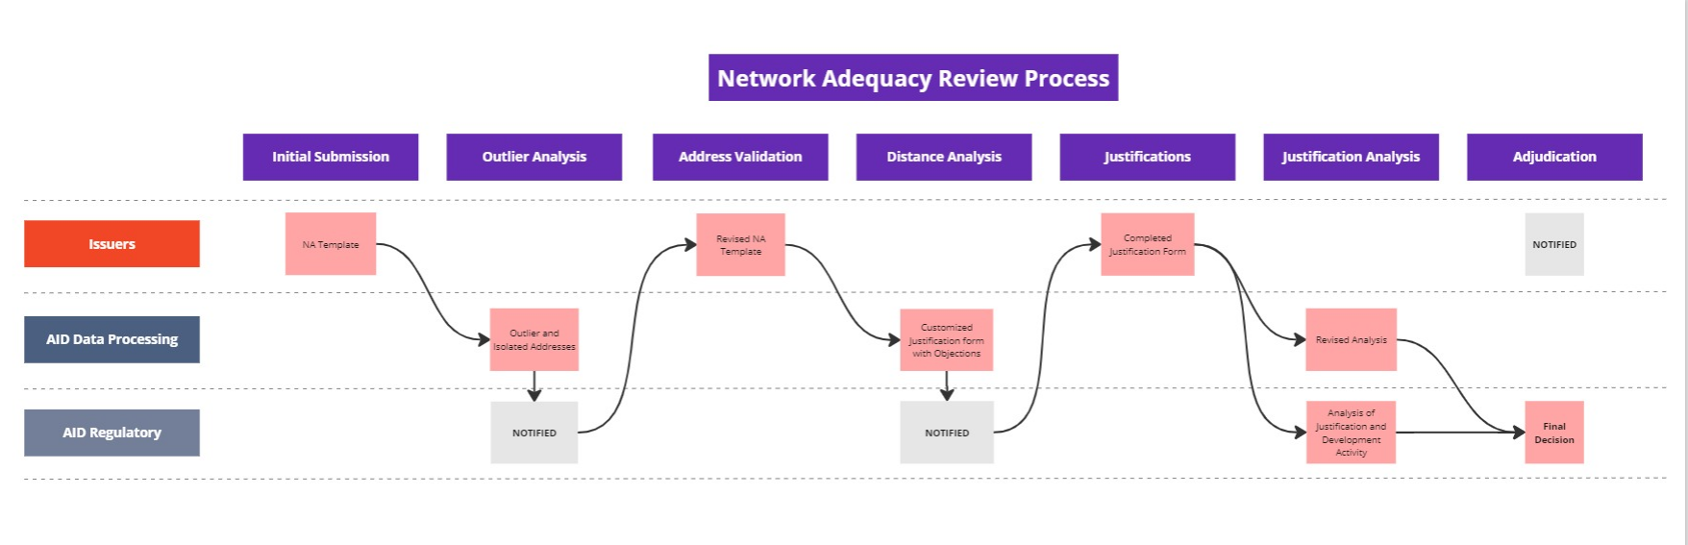
Round 0

Slide 18
After data submissions
Round 0:
  AID identifies “outlier” addresses and shares with issuers.
  Issuers responds with revised NA templates if required.
Round 1:
  AID computes “ideal network” combining all networks.
    This is necessary for generating objections where improvement is possible. This also means “No providers available” is not a valid answer.
  AID computes individual networks and compares to ideal network to generate customized Justification Templates.
  Issuers responds with revised NA templates if required.
Round 2:
  For final dispositions, AID re-computes individual networks for for issuers who resubmitted NA templates at the end of Round 1

Slide 19
Round 1: AID’s na Computation
NA Template
(Detailed Data. NPI & Practicing locations)
Current Finalized Provider Type NPI Pool (PTNP)
(Provider classifications vetted by the industry)
Provider locations
Provider classifications
Consumer locations
CCIIO requirements
QHP Sample Population file
(Provided by CCIIO.)
CCIIO NA Drive Distance for each Provider Type & Medicare County type
AID’s Computation of coverage %
Network Shortcomings
AR Justification Template
(Justifications for shortcomings on county level statistics for different provider types)
Customized

Slide 20
Round 1

Slide 21
After data submissions
Round 0:
  AID identifies “outlier” addresses and shares with issuers.
  Issuers responds with revised NA templates if required.
Round 1:
  AID computes “ideal network” combining all networks.
    This is necessary for generating objections where improvement is possible. This also means “No providers available” is not a valid answer.
  AID computes individual networks and compares to ideal network to generate customized Justification Templates.
  Issuers responds with revised NA templates if required.
Round 2:
  For final dispositions, AID re-computes individual networks for for issuers who resubmitted NA templates at the end of Round 1

Slide 22
Round 2: AID’s na Computation
NA Template
(Detailed Data. NPI & Practicing locations)
Current Finalized Provider Type NPI Pool (PTNP)
(Provider classifications vetted by the industry)
Provider locations
Provider classifications
Consumer locations
CCIIO requirements
QHP Sample Population file
(Provided by CCIIO.)
CCIIO NA Drive Distance for each Provider Type & Medicare County type
AID’s Computation of coverage %
Network Shortcomings
AID internal report for final disposition

Slide 23
Round 2

Slide 24
Round 0
Round 1
Round 2
Tentative Review Timelines

Slide 25
Agenda
Introductions
Rule 106 change: When?
PTNP final list.
  The one version of truth for provider classifications – not the NA template
  Problems to mull over for action in the next round (June-July?)
    High volume of PCP-Specialty combinations for the same provider
    Acute care Hospitals in Arkansas
Changes in data preparation by Issuers
  Specialty Access Template no longer used
  Justification Template redone
Processes after data submission
  The multiple rounds including “outlier” location review
  Tentative timelines for the multiple rounds
Review new customized justification form
Outlier location review
  What we have so far in this POC

Slide 26
Customized Justification Form
Objectives:
  Present all network concerns in one document
  Consolidate communication; eliminate back-and-forth
  Ensure effective responses with validation
Action:
  Single Excel document presenting both objections and network development efforts
  In-document validation to pre-check responses
  Web-based upload on rhld.insurance.arkansas.gov
Demonstration

Slide 27
Agenda
Introductions
Rule 106 change: When?
PTNP final list.
  The one version of truth for provider classifications – not the NA template
  Problems to mull over for action in the next round (June-July?)
    High volume of PCP-Specialty combinations for the same provider
    Acute care Hospitals in Arkansas
Changes in data preparation by Issuers
  Specialty Access Template no longer used
  Justification Template redone
Processes after data submission
  The multiple rounds including “outlier” location review
  Tentative timelines for the multiple rounds
Review new customized justification form
Outlier location review
  What we have so far in this POC

Slide 28
Outlier Locations Processing
Objectives:
  Improve quality and consistency of provider locations across networks
  Perform clean-up where possible before distance requirement analysis
Action:
  Identify singular provider locations isolated from others’
  Present findings as economically as possible
  Provide opportunity for correction in “Round 0”
Demonstration

Slide 29


Discussions & Questions
Email
RHLD.DataOversight@arkansas.gov

